Slide 1


Slide 2
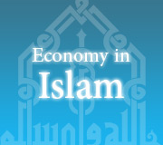
Topic
Islamic Economic System

Slide 3
ISLAMIC
WAYS
OF
TRADE

Slide 4
Trade and commerce have always been a part of Islam. From pre-Islamic days, the Holy City of Mecca has been the center of commercial activities. The early Muslims were not only engaged in trade but they went to distant lands in connection with business. Prophet Muhammad(PBUH) was himself engaged in this profession before he became a prophet. He was a successful businessman. Known for integrity, he bore the honorific title, the Trustworthy.

Slide 5
Business Ethics in Islam
Trust
Islam teaches us that when we believe and trust ALLAH than we should trust others. There is no basic conflict between good business practice and profit making in Islam.
2. Justice and Honesty
Justice can be defined as just conduct, fairness exercise of authority in maintenance of right and fair dealing between each other regardless of faith is strictly laid down in Islam.

Slide 6
3. Mutual Respect
The third principle is mutual respect and consideration for others is also inherent in the moral teachings of Islam. In business relationships Islam strictly forbids any discrimination between people based on their religion, sex, or gender.

Slide 7
What is forbidden in business in Islam?
Islam has not permitted producing, selling and purchasing of goods, which are prohibited in Islamic law. Alcohol, Drugs.. The Prophet of Islam has said: "When God prohibits a thing He prohibits (giving and receiving) the price of it as well."
Islam condemns hoarding to make high profit at the cost of public interest. Islam, however; allows normal trade - buying and selling of goods again and again at a reasonable profit.
Islam prohibits fraud in business dealings. The Prophet has said: "Sell the good and bad separately. He who deceives is not of us"

Slide 8
Islam prohibits buying or selling what is legal if we know that it will be used for illegal use: weapons, drugs and so on.
Muslims are not allowed to pay or receive interest. This is a shared value in all religions. The Quran is explicit about it and says, "God- has permitted for you trade and prohibited interest“.

Slide 9
Haram jobs
Alcohol Distribution
Drug Dealing
Music
Terrorist Organizations

Slide 10
Halal jobs
being a doctor is halal because you are helping people.
lawyer - if you're standing up for justice.
Teaching is a halal job because you are transfer the knowledge.
Farming is also a halal job.

Slide 11
HADITH
The Prophet (P.B.U.H) said:
An honest and truthful businessman shall be in the shade of the throne of Allah.
Our Prophet Muhammad (P.B.U.H) has said, “Whosoever accepts returned products, Almighty Allah will wipe-out his punishment.
Almighty Allah’s mercy descends on one who is gentle at the time of buying, selling, and requesting payment.

Slide 12
Prophet Muhammad (P.B.U.H) said whosoever sells a defective product without disclosing its defect to the purchaser, shall earn the permanent anger of Almighty Allah and the angels continuously curse such a person.

Slide 13
SOOD
The Interest Usury

Slide 14
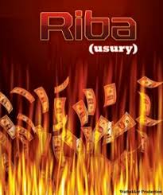

Slide 15
INTRODUCTION
The literal meaning of interest or Ribah as it is used in the Arabic language means to excess or increase.
In the Islamic terminology interest means effortless profit or that profit which comes free from compensation or that extra earning obtained that is free of exchange.

Slide 16
SOOD IN LIGHT OF QURAN AND AHADEES
"That which you give in usury for increase through the property of people will have no increase with Allah: but that which you give for charity seeking the countenance of Allah, it is these who will get a recompense multiplied." (Surah Rum verse no: 39)

Slide 17
SOOD IN LIGHT OF QURAN AND AHADEES
Second revelation (Surah al-Nisa verse 161) “and for their taking interest though it was forbidden for them, and their wrongful appropriation of other people’s property; we have prepared for those among them who reject faith and obey God and the prophet so that you may receive mercy”.

Slide 18
SOOD IN LIGHT OF QURAN AND AHADEES
Hazrat Jabir radiyallahu anhu has reported that the Messenger of Allah sallallahu alaihe wasallm cursed the devourer of usury, its payer, its scribe and its two witnesses. He also said that they were equal (in sin).

Slide 19
SOOD IN LIGHT OF QURAN AND AHADEES
Hazrat Al-Khudri radiyallahu anhu reported that the Prophet sallallahu alaihe wasallm said: Gold in exchange for gold, silver in exchange for silver, wheat in exchange for wheat, barley in exchange for barley, dates in exchange for dates, salt in exchange for salt is in the same category and (should be exchanged) hand to hand, so who ever adds or demands increase he has practised usury. The giver and taker are the same.

Slide 20
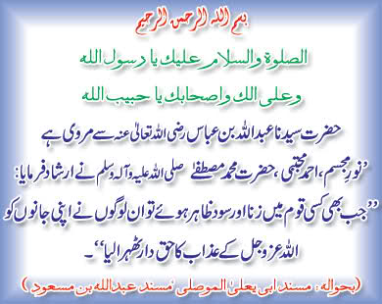

Slide 21
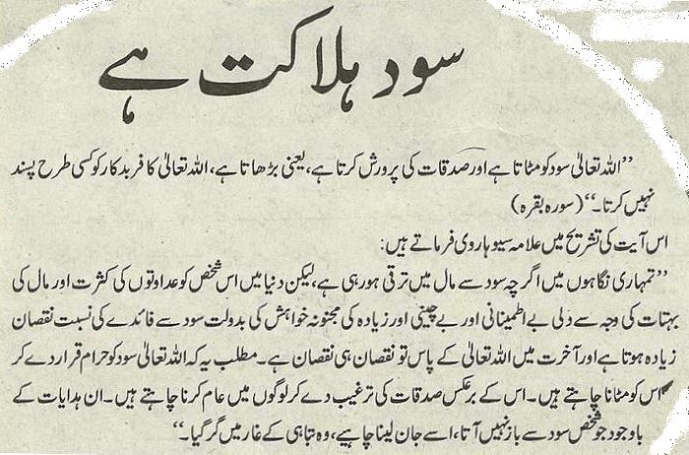

Slide 22
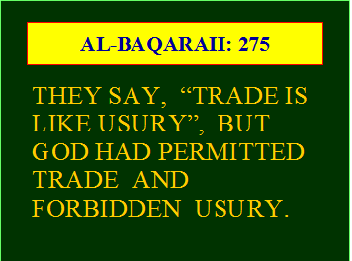

Slide 23
ISLAMIC ECONOMIC SYSTEMS
Islamic economic system is the study of Muslim behavior who organize the resources, which are a trust, to achieve falah.

Slide 24
BASIC CONCEPTS
The fundamental principle of this system has been laid down in the chapter The Cow (baqqarah) in the verse: “... They ask thee how much they are to spend; Say: ‘What is beyond your needs’.

Slide 25
CONTINUE
Āisha said that during the illness of God’s messenger she had six or seven dinars belonging to him which he ordered her to distribute, but she was kept busy administering to his suffering. He asked her what had happened to the six or seven dinars, and when she replied she had done nothing about them because she had been kept busy administering to his suffering, he called for them, and placing them in his hand he said, “What would God’s prophet think if he were to meet God Who is great and glorious while possessing these?”

Slide 26
CONTINUE
‘Abū Huraira[R.A] said that when the Prophet once visited Billāl and saw he had a heap of dates, he asked him what it was. On his replying, “It is something I have stored up for tomorrow,” he said, “Are you not afraid of tomorrow you may see on account of it steam in the fire of jahannum (Hell) on the day of resurrection?

Slide 27
CONTINUE
In this system no extra house or building will be allowed to build for renting or leasing out. Islam encourages only that much which fulfils ones genuine needs;

Slide 28
PRINCIPLES
Basic principles,
Distribution of money
Riba
Ways of trades and commerce

Slide 29
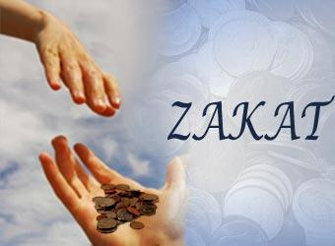
Topic
Mean of distribution of wealth, (Zakat)

Slide 30
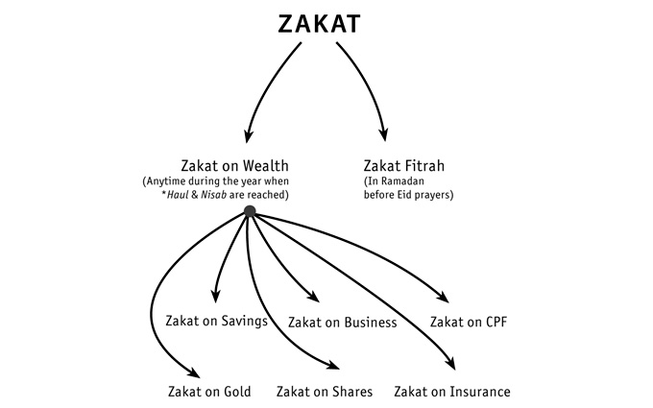

Slide 31
Meaning
Zakat means, “Purity”, “Cleanliness” or “to growth”
Zakat was made compulsory after the migration in Madina period, and
the holy prophet prescribed rules for the payment of Zakat.

Slide 32
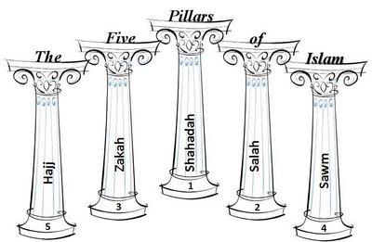
Islamic pillars
Touheed, Namaz, Zakat, Roza & Hajj.

Slide 33
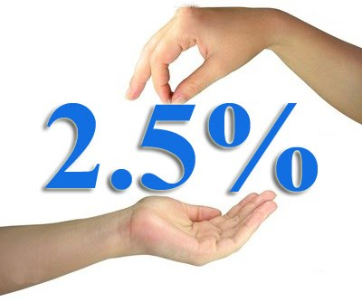

Slide 34
Limit of wealth.
Gold 7.50
Jewelry 52.50
Or the equal prize of jewelry which now is approx. 70,000
On the 100 2.50
On the 1000 25 rupees
Total 1750

Slide 35
Zakat is to be paid.
In Surah Tauba ayah no 60
8 points given about Zakat

Slide 36
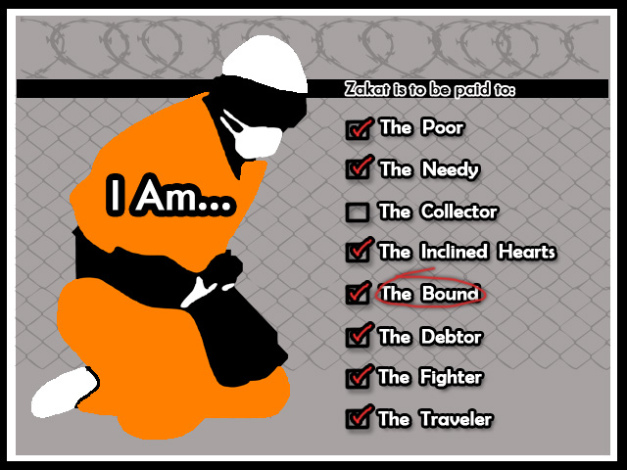

Slide 37

Advantages of Zakat paying.

Slide 38
Advantages of Zakat paying.
Goodness for society
Fulfill the needs of needy persons
Sympathy, honor of giver people.
Money does not stop at anyone it changes to other
Love with Allah

Slide 39
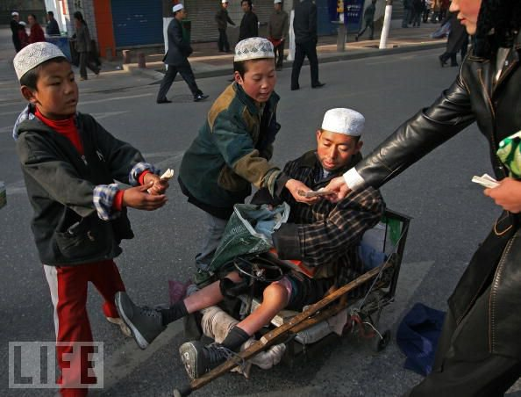

Slide 40
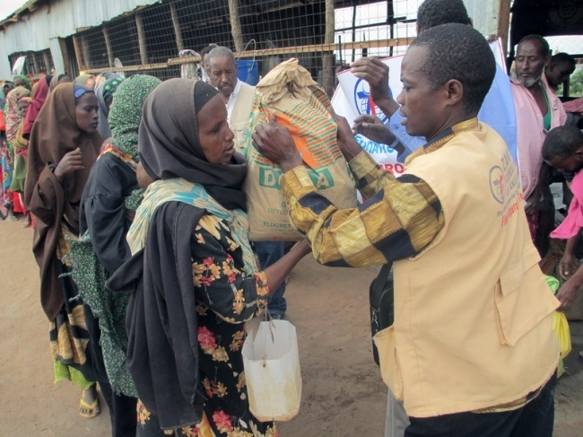

Slide 41
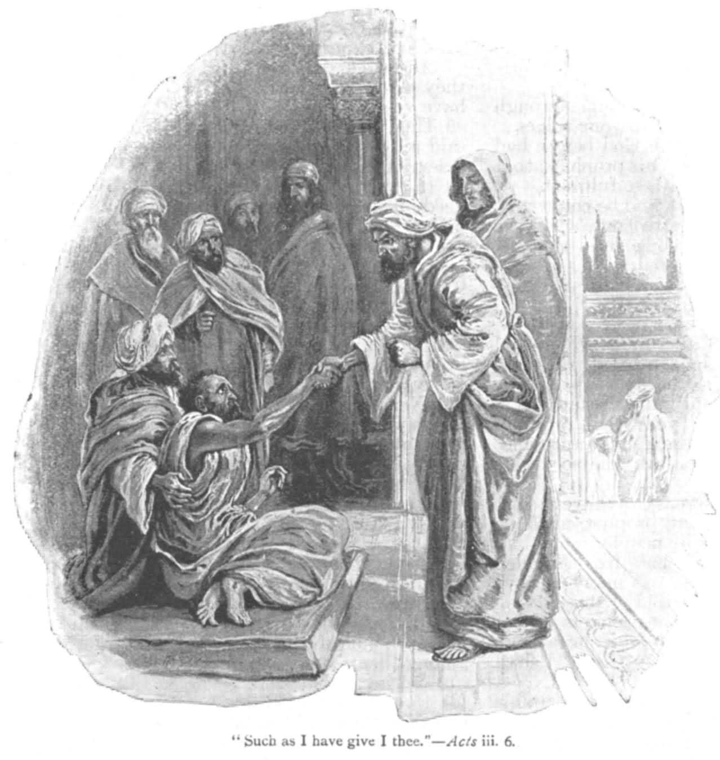

Slide 42
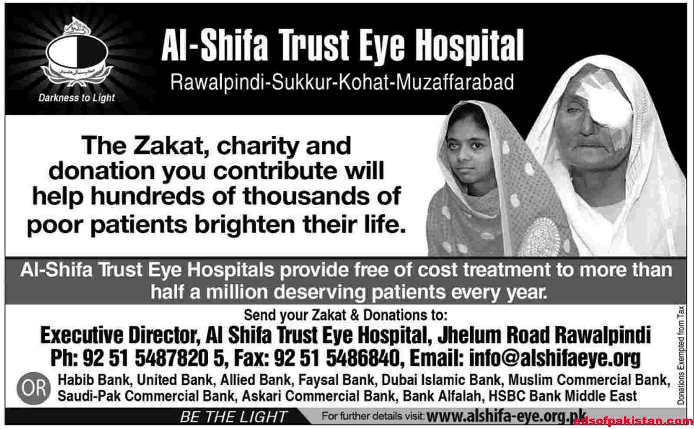

Slide 43
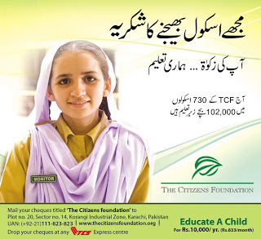

Slide 44
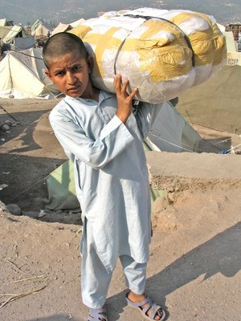

Slide 45
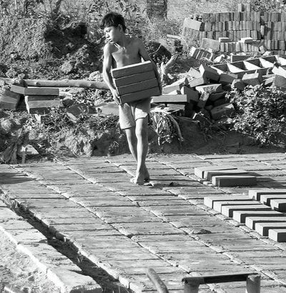

Slide 46
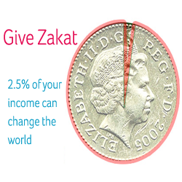

Slide 47
Doesn’t
If anyone able to pay but doesn’t.
In Surah Tauba Ayah no 34-35 said…………………..

Slide 48
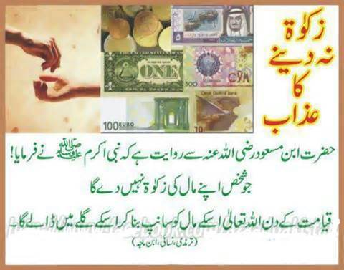

Slide 49


Slide 50


